Slide 1





Using Selective Memoization to Defeat Regular Expression Denial of Service
James Davis
Francisco Servant
davisjam@purdue.edu
Dongyoon Lee
fservant@vt.edu
dongyoon@cs.stonybrook.edu
Notes:
Hello.

Slide 2
Contributions
Anti-REDOS approach: Memoization
New Finite Automaton model
Algorithmic and run-time optimizations
Extensions to non-Kleene features
Evaluation
Notes:
New FA model for memoization
Algorithmic and run-time optimizations
Supports the full range of extended regex features
Evaluated on a large-scale corpus and showed benefits for a wide range of regexes

Slide 3
Background and Motivation

Slide 4


Regexes 101
[M&P ‘43, K ‘51]
/a+/
Concept
Simple string languages
~40% of SW projects
Not “regular”
[C&S ‘16]
Examples
[C&S ‘16, D’18, M ‘19]
\S+ @ \S+ \. \S+ ← Email
\d{1,3} \. \d{1,3} \. \d{1,3} \. \d{1,3} ← IPv4
^[a-zA-Z0-9]+ ( [._]? [a-zA-Z0-9]+ )* $ ← Username
Notes:
Regular expressions are a popular tool for string matching problems.
Conceptually, regexes are a means of encoding a
* Simple string languages: like “strings that look like email addresses”.
* Regexes are widely used in practice.
* Regexes ain't regular: Most programming languages offer about 30 distinct regex operations. Some of these go beyond Kleene-regular semantics.
* According to empirical studies, software engineers commonly use regexes to perform input validation.
Engineers use regexes as an early step when processing untrusted and unstructured text.
For some examples:
* Here is a regex that matches email addresses
* Another one for IPv4 addresses
* And one for Windows usernames
At run time, the responsibility for checking matches is delegated to an entity known as a regex engine.
===
* Practitioners have extended regular expressions beyond automata 101.
Real-world regexes are expressive enough that you can encode NP-hard problems with them.
* But various researchers have showed that
* Although some regexes have linear worst-case match time,
* Other regexes will have polynomial
* Or even exponential worst-case match times as a function of the length of the input

Slide 5


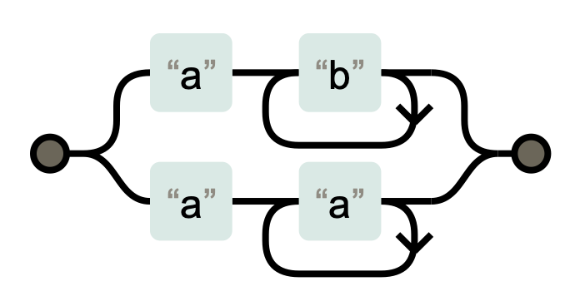



How most regex engines work
[S ’94]
What’s a regex engine?
match(regex, string) ← “Does this regex match this string?”
How do they work?
ab+ | aa+
Simulate on input
“aaa”
Depth-first backtracking search
Notes:
Every mainstream programming language offers engineers a regex engine to answer “match” queries.
* In their implementations, they take a regex pattern like this one,
* and convert it to a construct similar to a Non-deterministic Finite Automaton (or NFA).
* The regex engine then simulates the NFA on the candidate string to see if it can find a match.
* Here’s an example on the candidate string “aaa”
TRANSITION
* Most regex engines use what’s called a naive depth-first backtracking algorithm to search for a match.
Any time they come to a choice they write down all of the options, take the first one, and try the others later if the first option doesn’t work.
This approach is straightforward, but it introduces potentially problematic worst-case match performance – in other words, the regex engine may take a very long time to answer some match queries.

Slide 6

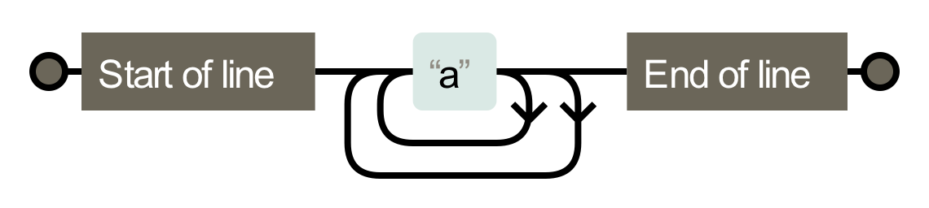
Ambiguity → super-linear worst-case behavior
[T ‘68, C ‘03, C ‘07, KRT ‘14, S ‘14]
Super-linear regex /^(a+)+$/
NFA
Slow input “aaaaa…aa!”
Mismatch - backtracking
Exponentially many paths
Notes:
* Here’s an example of a super-linear regex – it is similar to the previous example, but this regex has exponential worst-case behavior
* Regex engines will construct this NFA – like the previous NFA, but it has two loops instead of one
* because of the extra quantifier.
This extra loop makes the NFA ambiguous.
* Each additional "a" gives the engine two choices to explore, compounding exponentially
This means that
* under the input "aaaa....a!",
* there will be an exponential number of paths to explore in the number of "a"s.
* And the regex engine will try all of them to prove a mismatch
The situation isn’t this bad for all regexes. Unambiguous regexes have linear-time behavior; some regexes are poly-time, and only a few are exponential-time.
Regardless of their worst-case behavior, most regexes will run in linear time on typical inputs.
It often takes a malicious input to trigger the worst-case behavior.
TRANSITION
Let’s think about the implications of these properties when regexes are used within the web stack.
===

Slide 7




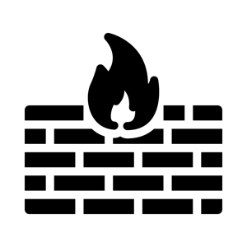






Regex-based DoS (ReDoS)
[S’94, C ’03, C&W ’03, S&P’18, D’18a, D’18b]
July 2019
O(n⁴) regex
July 2016
O(n²) regex
/a*/
/a*/
/a*/
/a*/
XSS in JS
Trimming posts
[D’19]
Most regex engines backtrack
Dialects preclude substitution
Notes:
…Let’s think about the implications of these properties when regexes are used within the web stack.
This diagram represents the typical parts of a web service:
* From the user through
* a web client
* past a firewall
* Into business logic
* Through persistent storage, and back again.
* All of these systems support a reasonably-consistent regex language.
* Any path a legitimate client can use, an attacker can use as well.
In a regex-based DoS attack, the attacker triggers a regex’s super-linear worst-case behavior, in a location that affects other clients (e.g. poisoning an event loop or a worker pool).
* ReDoS can affect individual web services like Stack Overflow,
* and it can affect many web services at once when it impacts CDNs and middleware like Cloudflare.
These are not one-off examples.
Recent research has shown that ReDoS-vulnerable regexes are common in major modules and major websites.
TRANSITION:
What’s frustrating about this class of attack is that it is, in some sense, beyond the responsibility of the application engineer.
ReDoS attacks take advantage of a weakness in “critical infrastructure”: the regex engines used in most programming languages.
To wrap up this part of my talk, I’d like to highlight two additional things about regex engines.
The first thing is that most regex engines use backtracking and expose applications to ReDoS
The second thing is that, although there are regex engines with linear-time guarantees, notably those in Rust & Go, Google’s RE2, and Intel’s Hyperscan, there are subtleties between regex engine dialects that render translation a tenuous task.
=======
In the cases of Stack Overflow and Cloudflare, there were no obvious bad actors, merely engineering mishaps.

Slide 8
Research highlights
Space-time memoization tradeoffs
Extensions to E-regexes
Efficient memo table representations
Notes:
Variations on the ReDoS attack have existed since the 1980s. Yet ReDoS continue to be a problem – so far it has defied a practical solution.
Alternative algorithms are well known, but not widely adopted.
We conjecture that the cause is technical inertia: regex engines are complex and divergent in their semantics, and maintainers are risk-averse.
Backwards-incompatible changes could have far-reaching effects.
Therefore, with these constraints in mind, we set out to identify a backwards-compatible approach that would protect an existing backtracking engine against ReDoS with minimal modification.
Our main results are:
Space-time complexity tradeoffs of memoization for regexes
Extensions to non-regular regex features
Run-time storage optimizations

Slide 9


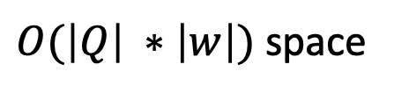
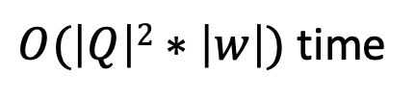
Approach: Full memoization
/(a+)+/
“aa…a!”
Vertex 1, offset 1
“a” (outer loop)
“a” (inner loop)
Vertex 1, offset 2
Vertex 1, offset 2
“a” (outer loop)
“a” (inner loop)
“a” (inner loop)
Vertex 1, offset 3
Vertex 1, offset 3
…
…
$O(\left|Q\right|2∗\left|w\right|)$ time
Theorem 1: Memoizing visits to every vertex yields
$O(\left|Q\right| ∗\left|w\right|)$ space
Similar to Packrat Parsing for CFGs [Ford 2002]
Notes:
…The general approach we’ll consider is called memoization.
It has been proposed in the past, but no one has explored how to make it cheap enough to be practical.
Let me explain first how FULL MEMOIZATION works.
* We’ve got our input, and the regex engine will simulate the automaton on this input.
Earlier I explained how regex engines work.
They employ a backtracking search,
and explore every potentially-feasible path through the automaton.
So while matching "aa!", we'll see redundant simulation paths through the regex’s automaton representation, like these:
* We start at vertex 1 (the vertex marked "a"), at string offset 1
* When we see an "a", we have a choice of the inner or the outer loop
* Let's favor the inner loop, so we'll move to position vertex 1, offset 2, and try the other path later
* We'll keep doing this and eventually mismatch
* Then we'll backtrack -- let's suppose we try the other choice back at the beginning
Now we're at position vertex 1, offset 2 again.
* From there, we can get to node 1, offset 3 again, and so on
You can see that we're retracing our steps along different paths.
The NFA simulation is visiting the same vertices at the same offsets over and over again.
That makes sense when you look at the definition of ambiguity.
A regex is ambiguous if there are multiple paths in the automaton that lead to the exact same place – it would be redundant to try both of them.
A natural solution to avoid redundant paths is a technique called memoization.
Essentially, memoization introduces bread crumbs into the NFA simulation,
and if the simulation encounters a bread crumb then it knows that that path didn’t work.
During the simulation, we can mark the vertex-offset pairs as we visit them, like so
*
*
Then when we backtrack, we can see the redundancy and short-circuit those paths.
I’ve proved an unsurprising theorem about this:
If we memoize visits to every vertex, the simulation will run in linear steps for the input w,
And it will require one copy of the string for each vertex being memoized.
TRANSITION
This is a great improvement in time complexity But since these strings can be long, it would be nice to reduce the space complexity.
=====
Also note that unlike changing the core algorithm, with memoization it is easy to prove that the engine’s semantics will be preserved.
This result is similar to the one for CFGs provided by Ford in 2002.

Slide 10
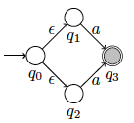
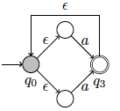

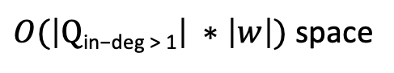

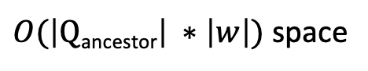
Lower complexity via selection
[A’03]
a|a
Same time cost
Theorem 2: Memoizing visits to $Q$_{in-deg > 1} yields
$O(\left|Q\text{in}\text{−}\text{deg}\text{ > 1}\right| ∗\left|w\right|)$ space
(a|a)+
Larger time cost in Q
Theorem 3: Memoizing visits to $Q$_{ancestor} yields
$O(\left|\text{Q}\text{ancestor}\right| ∗\left|w\right|)$ space
Notes:
This is a great improvement in time complexity But since these strings can be long, it would be nice to reduce the space complexity.
Many real-world regexes are complex, with tens and even hundreds of NFA vertices.
Combined with long input strings, the space cost may be too much for practical purposes.
* Fortunately, we have shown that we can memoize visits to a selected subset of the vertices, obtaining the same time guarantee with lower space cost. These are the automaton vertices with in-degree > 1, which result from quantifiers and disjunctions – these vertices can be reached along multiple paths. Since ambiguity means multiple paths, it makes sense that we can only memoizing to get the same effect.
* But remember that it’s the compounding of paths through loops that’s really problematic. What if we just focus on those?
* We’ve shown that we can memoize still fewer vertices to trade a slightly larger time cost for even less space. Here we memoize the “ancestor” nodes, i.e. the automaton vertices upstream from back-edges in the automaton graph. Memoizing these does not prevent *all* ambiguity, but it prevents the ambiguity from compounding.
We also extended our memoized non-deterministic automaton model to two common extended regex features: regexes with zero-width assertions (lookarounds) and regexes with backreferences.
Our formalization followed regex engine implementations: we introduced additional edge types into the automaton, and considered the memory costs and the effect of memoization.
TRANSITION
So, using selective memoization, we can reduce the space cost without degrading the linear time guarantee. But nothing is free -- we still have to pay a space cost, and we'd like to reduce that cost as much as possible.
In the paper, we discuss encoding schemes for the memo table, one of which is quite promising.
=======
The 75th percentile of both all regexes and only the super-linear regexes is between 30 and 40 (31 and 38, respectively)
Whiskers are the (1,99) percentiles.
Measure is of 150K regexes from the corpus of 537K, i.e. about 29%.
The remainder use features that the prototype does not support.

Slide 11
Experimental Results
Security: Do our theorems work?
Practicality: Space complexity & actual cost
Notes:
We implemented these ideas in a prototype memoized regex engine, building on a simple engine by Russ Cox.
We conducted two kinds of experiments on the largest extant regex dataset, with half a million regexes including 50K super-linear regexes.
Our prototype is mature enough to support 84% of this dataset, including 95% of the super-linear K-regexes.
======
This corpus contains 537,806 regexes from 193,524 software projects, including 51,224 super-linear K-regexes and inputs to trigger worst-case behavior.
In prior work, we collected this corpus and showed that its properties are reasonably consistent across programming languages, so it is “the best we’ve got” in terms of assessing practical applicability.
Prototype supports 454K regexes, 48505 SL (K-)regexes

Slide 12
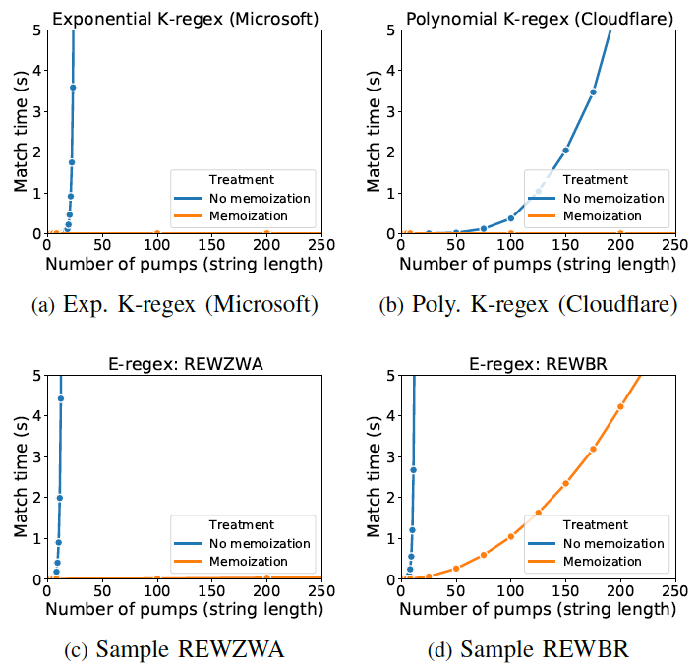
Security experiment
Notes:
These figures illustrate the reduction in matching times resulting from memoization on several examples.
* X axis
* Y axis
* Here we have the exponential user-name regex from Microsoft
* The Cloudflare regex
* A regex with zero-width assertions, and one with backreferences
Each figure follows the behavior predicted by our theorems for K-regexes and Extended-regexes.
In a larger experiment, we tested each supported super-linear (K-)regex with problematic inputs of varying lengths. Our theorems correctly predicted the number of visits for different memoization schemes.
Our prototype achieved linear-in-the-input performance with memoization.
TRANSITION:
The time reductions are great, but we cannot just move the cost from the time domain into the space domain.
How practical is our approach in terms of space costs?
======
We varied the length of each input, from 10,000 pumps to 100,000 pumps at intervals of 10,000.

Slide 13
Practicality: Space complexity
“Memo multiplier”
Notes:
…to start with, let’s look at the space complexity of our approach on the regex dataset.
The x-axis indicates the vertex sets of interest.
The y-axis shows the sizes of the vertex sets for each selective memoization schemes.
Whiskers indicate the (1, 99)th percentiles. Outliers are not shown.
The blue bars are “all supported regexes”; the orange bars are for the super-linear subset.
* First, our data show that full memoization would be costly, with an order-of-magnitude increase in storage cost over the original string.
Second, our data show that the selection schemes will typically have a much smaller multiplier, for both normal and super-linear regexes.
TRANSITION:
This is promising! But how do these complexities manifest as space costs during a realistic attack?

Slide 14
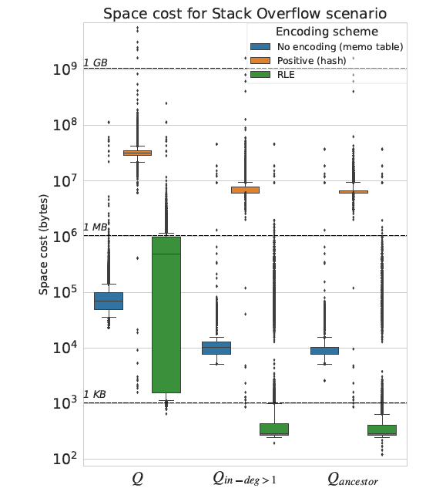
Practicality: Space cost
By encoding scheme
“Untenable”
Space cost
“Pricy”
Memo scheme
“Cheap”
Notes:
This is promising! But how do these complexities manifest as space costs during a realistic attack?
Space costs to evaluate super-linear K-regexes with “Stack Overflow”-sized input strings (20 KB).
Y-axis is a log scale.
Whiskers indicate the (5, 90)th percentiles.
Using the coarse metrics of “1 KB is cheap”, “1MB is pricy”, and “1GB is untenable”, our data show that:
In the orange bars, positive encoding via a hash table is untenable
In the blue bars, a simple memo table is “untenable” but reduces to ”pricy” with selection
In the green bars, an efficient encoding scheme starts out “pricy” but reduces to “cheap” with selection
* In fact, selection + encoding = typically constant space costs in our experiments.
TRANSITION
Pause.
This concludes the measurements I’ll present; there are more in the paper.
In conclusion…
======
the RLE representation (green) achieves constant space costs for most regexes. It has a 95th percentile of 16 runs for Qin􀀀deg>1 and 10 runs for Qancestor. This scheme breaks down when run length and visit sequence are mis-aligned. Determining the limitations of RLE is a task we leave for future work
The space costs of a scheme depend on the regex, the input, and the memo function representation. For each supported super-linear regex, we used the “most evil” (highest growth rate) of the inputs from the detectors. We measured the space used under each combination of selection scheme and memo function representation. For this experiment we used strings of length 20 KB to simulate the Stack Overflow scenario.

Slide 15

Conclusions
We want to fix ReDoS!
Selective memoization might be the answer.
http://github.com/PurdueDualityLab/memoized-regex-engine/
Notes:
The ReDoS problem has thus far defied a practical solution. In this paper we revisited this problem from a data-driven perspective.
Grounded in a new large-scale regex corpus, we proposed two selective memoization schemes that offer attractive time complexity guarantees with low space complexity.
In experiments, our ReDoS defense offers linear-time behavior with constant space costs for 90% of super-linear regexes.
In summary, it appears that the combination of selective memoization and a good encoding scheme can eliminate ReDoS with minimal space costs.
In future work, we are examining bounds on the encoding scheme cost, and working towards implementation in real-world regex engines.
Thanks for your attention!

Slide 16
Bonus slides

Slide 17
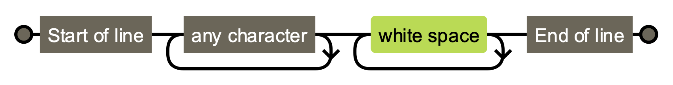

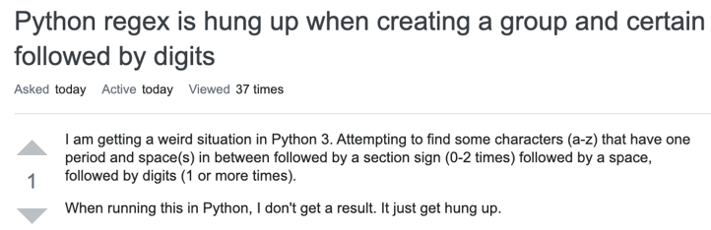
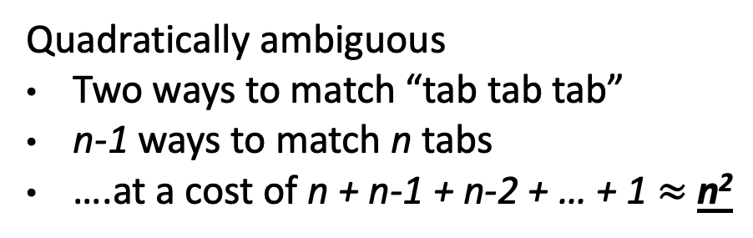
Stack Overflow Outage – July 2016
/^.*\s+$/
Quadratically ambiguous
Two ways to match “tab tab tab”
n-1 ways to match n tabs
….at a cost of n + n-1 + n-2 + … + 1 $≈$ n²
Notes:
I suspect we're all familiar with the question-and-answer forum Stack Overflow.
In July 2016 they experienced a 34-minute service outage caused by a super-linear regex evaluation, preventing users from posing questions or answering them.
At a rough estimate, during this outage 200,000 visits were disrupted, affecting tens of thousands of users.
The cause?
* Stack Overflow posts look like this: a title, then a few lines of a question.
Responses look similar.
* You can't see this, but there is no whitespace at the beginning or the end of each line.
This makes sure that the posts look pretty on laptops, desktops, and mobile devices,
and also saves Stack Overflow a bit of money by reducing their network traffic.
* Stack Overflow stripped this whitespace using a regular expression.
* This regular expression is ambiguous -- you can match whitespace characters either in the first loop or the second one.
* There are linearly many different paths through it, leading to a quadratic runtime cost.
Quadratically many isn't too bad -- it grows slowly, so slow behavior only manifests on fairly long strings.
As it turns out, somewhere on Stack Overflow was a post with over 20,000 tab characters, and one day this post reached the front page of SO.
Now, SO had a canary system in place: The health of each server was checked by its ability to load the front page within a time limit.
The cost of processing this post with this regex exceeded the time limit, and each server was marked down in turn.
This moved more and more load to the survivors, who were themselves eventually marked down, leading to a sitewide outage.
TRANSITION
Let’s take a look at other places a Regex-based service outage could crop up.
====
In early 2020, Stack Overflow received about 10 million visits per day, so a rough estimate suggests that a 34-minute outage would affect over 200,000 possible visits.
Post #38484433 (20,507 whitespace characters in the middle of a line)

Slide 18




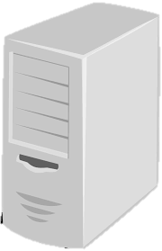




Regular Expression Denial of Service (ReDoS)
[C ’03, C&W ‘03]
/^.*\s+$/
“\t\t\t…\t!”
<normal traffic>
Notes:
Let’s say this is Stack Overflow’s server.
* They are applying this regex on posts –untrusted input from clients.
* If a malicious user (or just a bizarre one) creates a post with tons of tab characters,
* then SO’s server dedicates an unusual amount of computational resources to this regex match,
* And legitimate users
* are denied service – they cannot ask questions or give answers.
Crosby called this situation Regex Denial of Service, or ReDoS.
This kind of denial of service attack has two immediate effects.
First, as you can see, legitimate users cannot access the service.
* Second, a ReDoS attack costs the company providing the service money!
They are wasting computational resources (e.g. increasing their cloud spend).
And if the company uses an advertising revenue model, those lost clients also mean lost advertising dollars.
TRANSITION
Stack Overflow is not the only company to run into problems with runaway regex evaluations
====
Remember that regexes are commonly used for input validation.
Form input is, by definition, untrusted and potentially malicious -- that's why we're validating it.
A malicious input could trigger the super-linear worst-case match time of a regex, leading to denial of service.
=====
Regex Denial of Service was proposed back in 2003 by Scott Crosby.

Slide 19



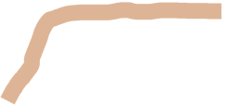
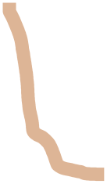
CloudFlare Outage – July 2019
CPU utilization (all machines)
100%
75%
50%
25%
0%
Regex rolled back
Outage
Regex deployed
13:45 13:50 13:55 14:00 14:05 14:10
Notes:
CloudFlare is an internet infrastructure company whose main offering is a content delivery network -- basically a cache for web services.
CloudFlare has a lot of customers: around 5% of all internet traffic flows through CloudFlare.
Last July, CloudFlare had an outage caused by an algorithm that began to receive worst-case inputs.
While CloudFlare was offline, its customers' services were inaccessible, impacting the bottom line
of companies like Uber, OKCupid, and Peloton.
CloudFlare’s engineers had developed a regex that run in linear time on most input.
They tested it on a small-scale deployment, and it performed just fine.
But when CloudFlare’s engineers deployed this algorithm worldwide, things went wrong.
A pathological group of network packets triggered the regex’s worst-case cubic behavior – much worse than the linear-time behavior they were expecting.
* This chart shows the CPU utilization on their servers during the outage.
* When the algorithm was deployed, CPU utilization spiked to 100%. Network traffic could not be processed because the machines were overloaded.
* Until CloudFlare’s engineers responded, thousands of Internet services were disrupted.
* Disrupted service is bad for everyone. Customers don’t get the services they want; companies don’t get paid; Trust in Cloudflare erodes.
TRANSITION
I can regale you with anecdotes about problematic regexes.
===
This algorithm typically behaved in linear time, but as the result of a change by CloudFlare's engineers it began to perform in cubic time on many inputs.
Some affected websites:
https://www.theverge.com/2019/7/2/20678958/downdetector-down-cloudflare-502-gateway-error-discord-outage
Other CloudFlare customers:
https://qz.com/918941/cloudflare-leaked-user-data-from-millions-of-websites-heres-how-to-check-if-you-were-affected/
5-10% of internet traffic:
https://www.wired.com/story/cloudflare-spectrum-iot-protection/
other web services might be vulnerable to an outage caused by a runaway regex.

Slide 20
ReDoS at CloudFlare (details)
“ReDoS regex” for XSS detection
(?:(?:\"|'|\]|\}|\\|\d|(?:nan|infinity|true|false|null|undefined| symbol|math)|\`|\-|\+)+[)]*;?((?:\s|-|~|!|{}|\|\||\+)*.*(?:.*=.*)))
Notes:
Here’s the problematic regex. I’m sure we can all see the trouble right away!
No? Well maybe a picture...

Slide 21
Simplified form
“ReDoS regex” for XSS detection
(?:(?:\"|'|\]|\}|\\|\d|(?:nan|infinity|true|false|null|undefined| symbol|math)|\`|\-|\+)+[)]*;?((?:\s|-|~|!|{}|\|\||\+)*.*(?:.*=.*)))
(\+)*(\+)*(\+)*(\+)*=
n²
Mismatch possible
n³
n⁴

Slide 22
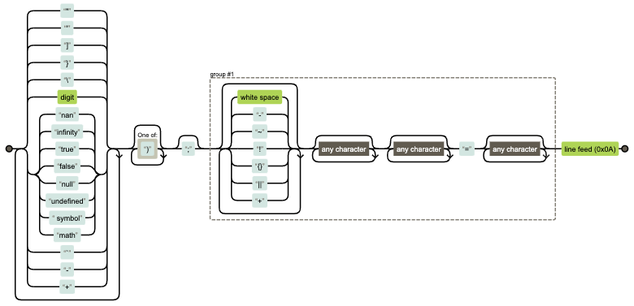
Perhaps a picture...
n⁴
n³
n²

Slide 23
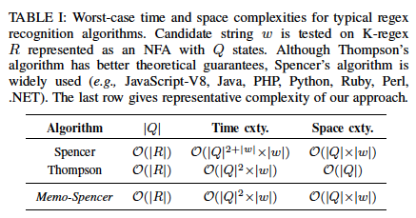
Summary of guarantees
Reduced by selection
Best-effort optimized by encoding

Slide 24
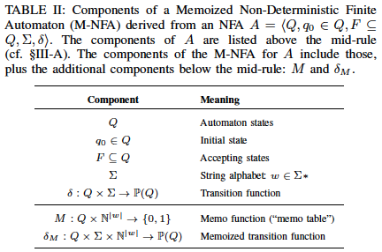
M-NFA model

Slide 25
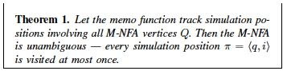
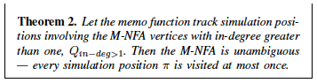
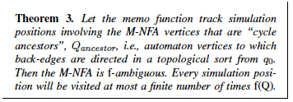
Theorems (proofs in appendix)

Slide 26
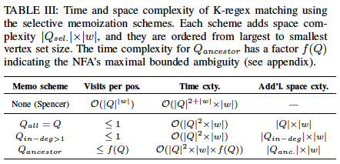
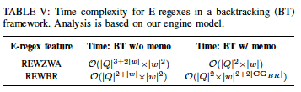
Resulting guarantees for K-regexes and E-regexes

Slide 27
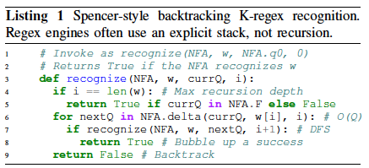
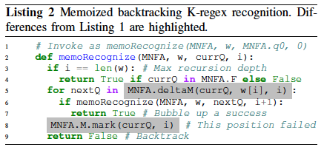
Integrating memoization

Slide 28
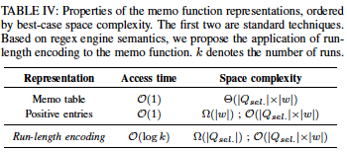
Memo function trade-offs

Slide 29













ReDoS defense space
{
...
}
B. Refactoring
[D’18]
/a*/
A. Resource limit
Spencer
Thompson
Brzozowski
D. Optimize
C. Algorithm
This work

Slide 30
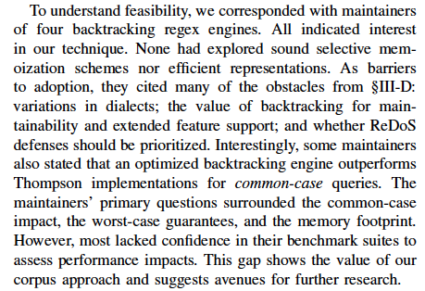
Regex engine maintainers’ perspectives

Slide 31
Regexes 101
[M&P ‘43, K ‘51]
/a+/
Concept
Core operations
Simple string languages
~40% of SW projects
ab ab
a* a, aa, aaa, …
a | b a, b
[C&S ‘16]
[C&S ‘16, D’18, M ‘19]
Examples
\S+ @ \S+ \. \S+ ← Email
\d{1,3} \. \d{1,3} \. \d{1,3} \. \d{1,3} ← IPv4
^[a-zA-Z0-9]+ ( [._]? [a-zA-Z0-9]+ )* $ ← Username
Notes:
Regular expressions are a popular tool for string matching problems.
Let me tell you what you’ll need to know about them.
Conceptually, regexes are a means of encoding a
* Simple string languages: some useful subset of all possible strings, like “strings that look like email addresses”.
They are supported in all mainstream PLs, and are widely used in practice.
* By one estimate, about 40% of software projects use regexes in one way or another.
Practically, engineers encode regex string constraints using
* three core regex operations:
* Concatenation, * repetition, * disjunction
Most programming languages offer about 30 distinct regex operations. Some of these go beyond Kleene-regular semantics.
* According to empirical studies, software engineers commonly use regexes to perform input validation.
Engineers use regexes as an early step when processing untrusted and unstructured text.
To refresh your memory, let me share some examples:
* Here is a regex that matches email addresses
* Another one for IPv4 addresses
* And one for Windows usernames
At run time, the responsibility for checking matches is delegated to an entity known as a regex engine.
===
* Practitioners have extended regular expressions beyond automata 101.
Real-world regexes are expressive enough that you can encode NP-hard problems with them.
* But various researchers have showed that
* Although some regexes have linear worst-case match time,
* Other regexes will have polynomial
* Or even exponential worst-case match times as a function of the length of the input

Slide 32
Ambiguity → super-linear worst-case behavior
[T ‘68, C ‘03, C ‘07, KRT ‘14, S ‘14]
Super-linear regex /^(a+)+$/
NFA
Slow input “aaaaa…aa!”
Recurrence relation
T(n) = 2*T(n-1)
= O(2^{n})
Mismatch - backtracking
Exponential paths to explore
Notes:
* Here’s an example of a super-linear regex – it is similar to the previous example, but this regex has exponential worst-case behavior
* Regex engines will construct this NFA – like the previous NFA, but it has two loops instead of one
* because of the extra quantifier.
What effect does this extra loop have? It makes the NFA ambiguous.
* Each time the regex engine encounters an "a", it's not sure which loop to take.
Each "a" gives it two choices to explore, and additional “a”s compound the number of paths exponentially.
This means that
* under the input "aaaa....a!",
* there will be an exponential number of paths to explore in the number of "a"s.
* This input ends in an !, ensuring that none of them will match and forcing the regex engine to try all of them.
* We can express the number of paths in this NFA using this recurrence relation, which works out to exponential in the length of the input.
* Not all regexes will have exponential worst-case time complexity under this search regime.
Some regexes exhibit polynomial worst-case behavior.
And unambiguous regexes will exhibit linear worst-case behavior.
Regardless of their worst-case behavior, most regexes will run in linear time on typical inputs.
They exhibit their slowest behavior only on specially crafted inputs.
TRANSITION
Let’s think about the implications of these properties when regexes are used within the web stack.
===

Slide 33
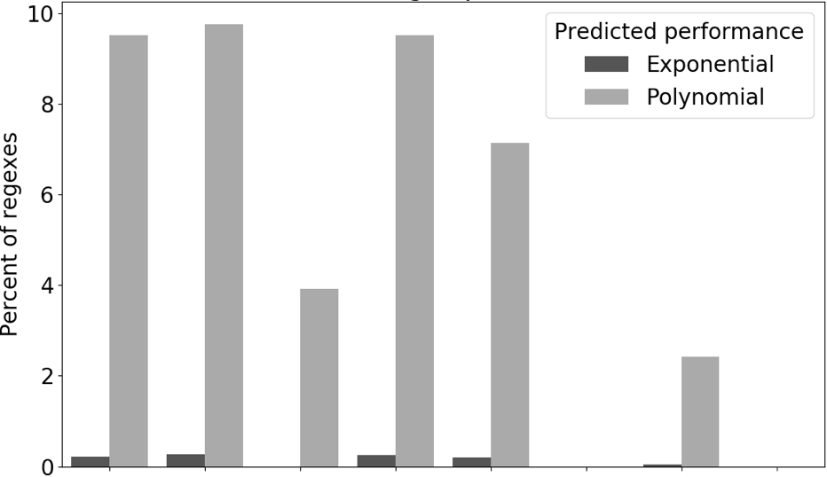
Regex engines use backtracking
[D’19]
Slow
Worst-case performance
Medium
Fast
Notes:
The first thing you should know is that most regex engines use backtracking and expose applications to ReDoS
Regex engines from popular programming languages can be categorized into three tiers of performance.
For each regex engine, this chart shows the percent of the regex corpus that exhibited exponential or polynomial worst-case behavior.
* First, we have four regex engines in a “slow tier”, and 2 engines in a “medium” tier. Regexes in these programming languages exhibit non-trivial levels of polynomial and/or exponential behavior, impacting up to 10% of the regexes in the corpus.
* Finally, we have engines in the “fast tier”. These use Thompson’s lockstep matching algorithm instead of backtracking, which constrains the featureset they can support. However, they exhibit no appreciable super-linear behavior.
TRANSITION
The second thing you should know is that, although there are regex engines with linear-time guarantees, notably those in Rust & Go, Google’s RE2, and Intel’s Hyperscan, there are subtleties between regex engine dialects that render translation a tenuous task.

Slide 34

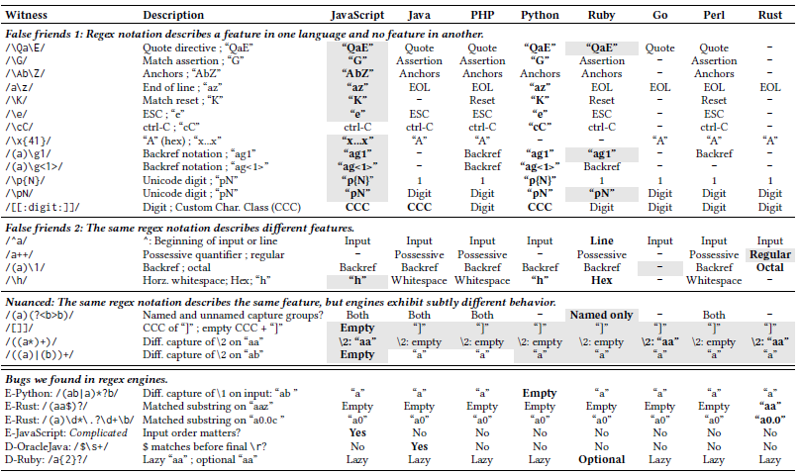

Regex engine dialects
[D’19]
Notes:
…The second thing you should know is that, although there are regex engines with linear-time guarantees, notably those in Rust & Go, Google’s RE2, and Intel’s Hyperscan, there are subtleties between regex engine dialects that render translation a tenuous task.
The existence of regex engine dialects is well known. My team measured the actual degree to which regex engines differ in their behavior, and identified two major kinds of differences.
* In this first group are behavioral differences that are well documented and can be easily addressed through a translation layer using existing compiler techniques.
* In the second group are behavioral differences that seem harder to translate – they don’t follow documentation, so they can only be discovered through experiments like this one. Some of them might then be translated, others less so. Formally representing these semantics has been a multi-decade effort by automata theorists – they are not done yet.
TRANSITION:
So, we want to eliminate ReDoS, but we must do so in an obviously-semantics-preserving way.
We don’t want to force developers to rewrite 10% of their regexes
We cannot just swap out one engine for another due to backwards compatibility; and
Overhauling an entire engine with a different (or hybrid) algorithm seems intractable – Google’s V8 team recently spent more than a year implementing such an approach.
Is there a simpler approach?

Slide 35
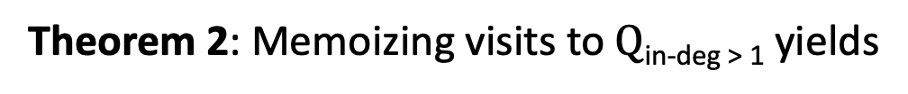
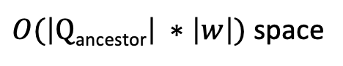
Reducing space costs via selective memoization
[A’03]
30x: too much space
Vive la différence
Typical space multipliers
Tighter distribution
|Q|
|Q_{in-degree > 1}|
|Q_{ancestor}|
Selected set of NFA vertices
Same time cost
Theorem 2: Memoizing visits to $Q$_{in-deg > 1} yields
$O(\left|Q\text{in}\text{−}\text{deg}\text{ > 1}\right| ∗\left|w\right|)$ space
Larger time cost in Q
Theorem 3: Memoizing visits to $Q$_{ancestor} yields
$O(\left|\text{Q}\text{ancestor}\right| ∗\left|w\right|)$ space
Notes:
…This approach offers a great improvement in time complexity.
But what about space costs?
A full memoization scheme requires making as many copies of the input string as there are NFA vertices.
Many real-world regexes are complex, with tens and even hundreds of NFA vertices.
Combined with long input strings, the space cost may be too much for practical purposes.
This chart shows the distribution of NFA sizes for a sample from a large regex dataset. The y-axis is thus the typical space multiplier for memoization.
* If we memoize all vertices, we’ll need 20 to 40 copies of the input string for typical regexes.
In some cases this might be acceptable.
But if input strings can be long, this space cost may be too much for practical purposes.
For example, the Stack Overflow problem from earlier involved very long input strings -- adding an order of magnitude to the memory costs in such cases could be problematic.
* Fortunately, we have shown that we can memoize visits to a selected subset of the vertices, obtaining the same time guarantee with lower space cost. These are the automaton vertices with in-degree > 1, which result from quantifiers and disjunctions – these vertices can be reached along multiple paths. Since ambiguity means multiple paths, it makes sense that memorizing these would suffice.
* For 99% of real-world regexes, this set of states is consistently quite small.
* I've gone further, and shown that we can memoize still fewer vertices to trade a slightly larger time cost for even less space. Here we memoize the “quantifier” nodes, i.e. the automaton vertices upstream from back-edges in the automaton graph. Memoizing these does not prevent *all* ambiguity, but it prevents the ambiguity from compounding.
* Estimating the real-world impact using our regex dataset again, this nets us a slightly tighter distribution than the previous scheme.
We also extended our memoized non-deterministic automaton model to two common extended regex features: regexes with zero-width assertions (lookarounds) and regexes with backreferences.
Our formalization followed regex engine implementations: we introduced additional edge types into the automaton, and considered the memory costs and the effect of memoization.
Due to time constraints, I won’t talk about the details here, but they are in the paper.
TRANSITION
So far so good – using selective memoization, we can dramatically reduce the space cost without degrading the linear time guarantee. But since we are still increasing the space cost, we’d like to reduce the cost as much as possible.
All of these memoization schemes involve tracking a table of the places we’ve been in our search. Can we choose an efficient representation of this table?
=======
The 75th percentile of both all regexes and only the super-linear regexes is between 30 and 40 (31 and 38, respectively)
Whiskers are the (1,99) percentiles.
Measure is of 150K regexes from the corpus of 537K, i.e. about 29%.
The remainder use features that the prototype does not support.

Slide 36
Full memo table
/(a+)+/
“aa!”
Vertex A
Vertex B
Vertex
1. Full memo table
 | A | B
1 - a
2 - a
3 - !
Fast access
Wasted space if unvisited
String offset
Notes:
…So far so good – using selective memoization, we can dramatically reduce the space cost without degrading the linear time guarantee.
Can we do better?
I’ll look at three ways to STORE the memo table, and we’ll see which one can do so the most efficiently.
* We’ll start out with what’s called a full memo table.
* Each column is the memoization record for a vertex
* Each row corresponds to an offset in the string
* We start by marking the outcome at each vertex-offset pair as unknown
* As we find cells that don’t work during the simulation, we’ll replace them
* with xs
During the simulation, if we encounter an X we know it won't work and can short-circuit. If we encounter an unknown, we will explore it.
* This scheme can be implemented with a bitmap, for fast access.
* It might waste a lot of space though – in column B we paid for a full copy of the input string that we didn’t use
TRANSITION
Perhaps we can do better by only paying for what we actually use.
=======
Whiskers are the (1,99) percentiles.
Measure is of 150K regexes from the corpus of 537K, i.e. about 29%.
The remainder use features that the prototype does not support.

Slide 37
Lower cost: Negative memo table
/(a+)+/
“aa!”
Vertex
2. Negative table
 | A | B
1 - a
2 - a
3 - !
Fast-ish access
No wasted space
String offset
 | A | B
1 - a
2 - a
3 - !
1. Full memo table
Notes:
…Perhaps we can do better by only paying for what we use.
* This approach is called a negative table – we’ll only mark places that WON’T work. This is a traditional technique in memoization.
* Again we have columns for vertices
* And rows for string offsets
* This time, we’ll start out with an empty table
* As we find failed paths, we’ll mark those
But we’ll never pay for cells we don’t visit.
* If we use a structure like a hash table, this gives us fast access and no wasted space.
TRANSITION
But perhaps we can do even better, by tailoring our table encoding to the problem context.
=======
Whiskers are the (1,99) percentiles.
Measure is of 150K regexes from the corpus of 537K, i.e. about 29%.
The remainder use features that the prototype does not support.

Slide 38
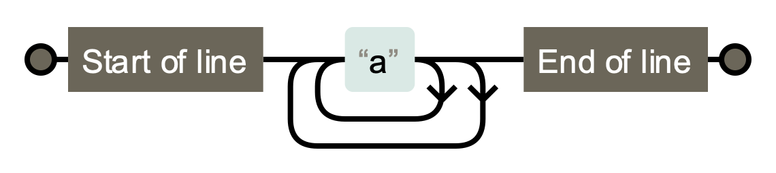
Lower cost: Run-length encoding
/(a+)+/
“aa!”
[Robinson 1967]
Vertex
3. RLE
 | A | B
1 - a
2 - a
3 - !
log(k) access
Run length affects compression ratio
String offset
1. Full memo table
2. Negative table
Notes:
…But perhaps we can do even better, by tailoring our table encoding to the problem context.
Look at the bottom two tables here – at the end of the simulation, both are low entropy, with a single value reused in every row – eminently compressible.
Perhaps we can take advantage of this low entropy by maintaining a compressed version of the memo table.
It turns out that we can achieve this by applying Robinson’s Run-Length Encoding.
* Here’s the table again.
This time, we’ll break up each column into runs, each of which is either a sequence of UNKNOWN or a sequence of KNOWN-FAILURE.
* We’ll start with one run of UNKNOWN per column.
* During the simulation, we introduce a run of KNOWN-FAILURE.
* But this run accretes during the simulation – we maintain low entropy throughout.
Why does this work?
Intuitively, this is caused by the backtracking search strategy necessitated by regex engines’ leftmost-greedy semantics.
The simulation follows a top- to-bottom, left-to-right search, exploring nearby string indices before further ones. This has the consequence that any runs within these automaton nodes will accrete as characters are processed, yielding consistently low entropy within each column.
* With an efficient data structure, we get logarithmic access to the columns, and low expected storage costs.
TRANSITION
Let’s see how these selection and encoding schemes stack up.

